Slide 1
Lesson 2.1
How to Add CSS to Your Web Design

Slide 2
Learning Outcomes
Use CSS in your website
Apply CSS styling in different approaches
Use CSS to color your website
Explore the uses of CSS from external websites

Slide 3
What is CSS?
CSS stands for Cascading Style Sheets
Describes how HTML elements are to be displayed
Advantages:
Powerful - can control the layout of multiple pages all at once
Efficient - can change the look of a website by just changing the CSS
Organized - external stylesheets are stored in “.css” files. Content is separated from design.

Slide 4
How to implement CSS?
There are 3 ways to insert CSS:
Inline Style (good)
Internal/Embedded Style Sheet (better)
External Style Sheet (best)

Slide 5
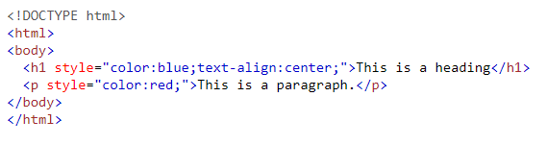
Inline Style
An inline style may be used to apply a unique style for a single HTML element by using the style=“” attribute and CSS code.
An inline style loses many of the advantages of a style sheet (by mixing content with presentation). Use this method sparingly.

Slide 6
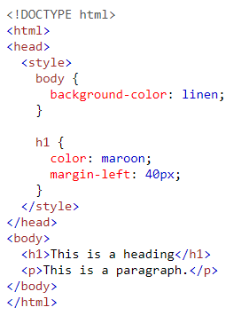
Internal Style Sheet
Internal style sheets may be used to apply a unique style to a single HTML page.
CSS code is defined within the <style></style> element, which is inside the <head></head> section of an HTML page.

Slide 7
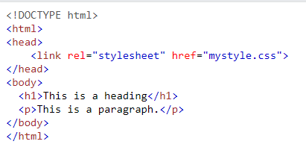
External Style Sheet
External style sheets may be used to apply a unique style to multiple HTML pages.
CSS code is written in a separate .css file (e.g. mystyle.css), then defined within the <link> element inside the <head></head> section of any HTML page.
“rel” names a relationship of the linked document to the current document.
“href” specifies the URL of the linked resource.

Slide 8
Order of “Cascading” Priority
What if you have more than one style specified for an HTML element?
Order of priority (where 1 is the highest):
Inline style
External or Internal style sheets (depending on which is read last in the <head> tag)
Browser’s default
Demo: Lesson_2.1_css_cascading.html

Slide 9
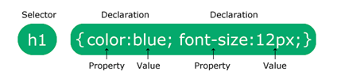
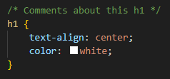
CSS Syntax
Selector
What are you targeting?
Always enclosed by curly brackets { }
Declaration(s)
Which property do you want styled?
How do you want to style it?
[property]: [value];
Comments
Starts with /* and finishes with */
Can be single or multi-line

Slide 10
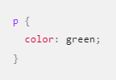
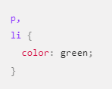
How to apply CSS to HTML elements
Target an element selector that directly matches an HTML element name.
You can target multiple selectors at the same time by separating the selectors with a comma.

Slide 11
CSS Demo
https://codepen.io/michael-dorsey/pen/vYvjQJW
Notes:
Use the code from Lesson_2.1_css_demo.html to show how CSS and HTML work in CodePen.

Slide 12
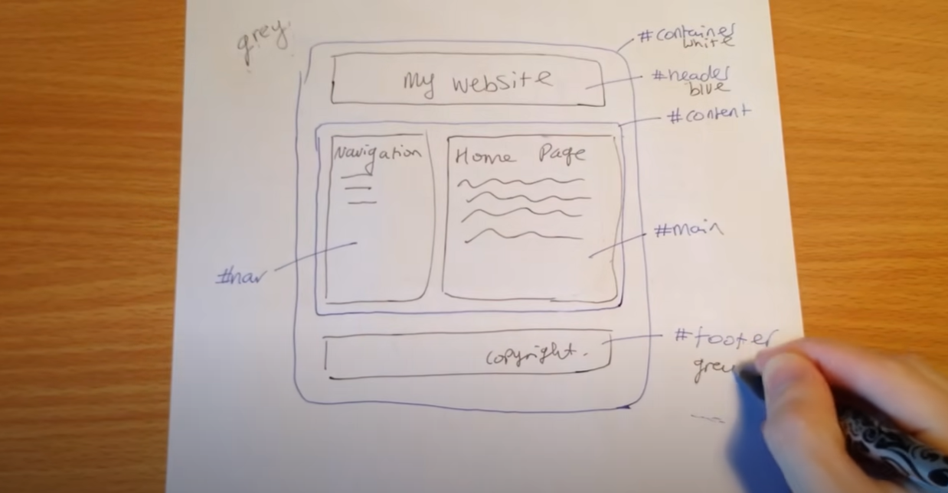
Pro Tip: do your designs on paper first

Slide 13
Learning Activities
2.1.1 – “Apply Styling Using a Combination of (a) Inline, (b) Embedded/Internal, and (c) External Styling Method”

Slide 14
For next class
Read Lesson 2.2
Do Learning Activity 2.2.1. We will do Learning Activity 2.2.2 in class together.
Assessments Reminder:
GLA 1 is due by February 13, 3:30pm
Assignment 1 is due by February 27, 3:30pm
Engagement is worth 10% of your final grade. Engage by sharing code, asking or answering questions, etc.
All assessment dates have been posted in the D2L calendar.
See the “Assignments Policy” for late submission procedures.

Slide 15
References

